Slide 1

EDUBRIDGE COURSE
CERTIFIED JAVA FULL STACK PROFESSIONAL
CORE JAVA PROJECT
PROJECT NAME: ONLINE BOOK STORE
UNDER THE GUIDANCE OF PRESENTED BY
Trainer Mrs. Indrakka Mali Mam DEEPIKA.S

Slide 2

AGENDA
INTRODUCTION
OBJECTIVES
ADVANTAGES
DISADVANTAGES
BOOKSTOREMAIN CLASS
MODULES DESCRIPTION
1.ADMIN MODULE
2.USER MODULE
DATABASE CONNECTION CLASS
ONLINEBOOKSTORE CLASS
FEATURE SCOPE
CONCLUSION

Slide 3
INTRODUCTION:
An Online book store is a virtual store on the Internet where customers can browse the catalog and select books of interest.
At checkout time, the items in the e-library will be presented as an order.
At that time, more information will be needed to complete the request.
Usually, the customer will be asked to fill in their details when they are ready to purchase.
This project intends different types of forms with many types of books like story, drama, romance, history, adventures, etc.
customers can choose many types of book categories, etc.
Here, the user may select the desired book and view its price.
The user may even search for specific books on the website.
Once the user selects a book, he then has to fill in a form and the book is provided for the user.

Slide 4
OBJECTIVE:
The business-to-consumer aspect of e-commerce is the most visible business use of the World Wide Web.
The main objective of the Online Book Store is to manage the details of Books, Customers, Payment, Delivery…
Using the Online Book Store project the user can purchase books online instead of going out to a book store.
Purpose of the project is to make a fully functional online book store system that allows its users to search and purchase a book online based on category, author, and price.
The selected books will be displayed in tabular form and then the user can pick and order one or more books online through cash or card payment.

Slide 5
ADVANTAGES:
Customers can get their book delivered instead of actually going and buying the book.
They can make payments online.
Managing inventory in the shop for shopkeepers becomes easier as customers are not visiting and ordering online.
This system saves both time and the traveling cost of customers.
Users can get to know different kinds of books that they were unaware of by just searching in the system using keywords.

Slide 6
DISADVANTAGES:
The only disadvantage is if the customer receives a book that is not in proper condition or has some kind of defect then there incurs an additional charge of posting it back.

Slide 7
BOOKSTORE MAINCLASS:
In this, the main class looks like the first page of the Online Book Store system.
It will give the choice like admin and customer/user.
If the person is an admin then it gives only a login option or if the person is a customer/user it will give registration and login options.
After the login, the admin can perform admin operations and the customer/user can perform the user operations.
Using an Online book store project the user can purchase books online instead of going out to a book store.

Slide 8

MODULE DESCRIPTION:
1.ADMIN MODULE
VIEWING BOOKS
ADDING BOOKS
UPDATING BOOKS
DELETING BOOKS

Slide 9
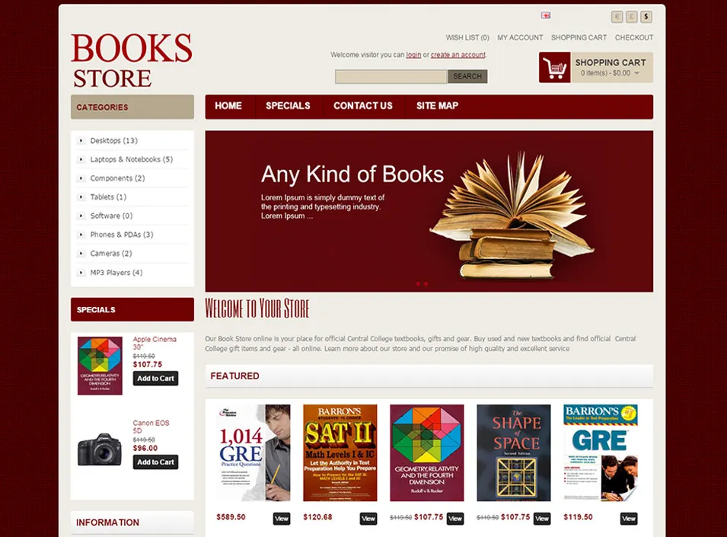
2. CUSTOMER MODULE/USER MODULE
LOGIN
VIEWING BOOKS
SEARCHING BOOKS
PURCHASING BOOKS

Slide 10
DATABASE CONNECTION CLASS:
In this class we are connecting the eclipse and MySQL software for the operations. We are making the connections to java code and SQL query.
For that connection: driver="com.mysql.cj.jdbc.Driver“
Here we are loading the driver in the pom.xml file after that it will create the dependency.
url=“jdbc:mysql://localhost:3306/ONLINEBOOKSTORE”
This url gives the path to connect the eclipse with MySQL. The host is localhost and port number 3306 is used here. And after that, the project name is given.
After this url the user name and password for that localhost we need to give.
Then the forName method is used for loading the drive at the runtime dynamically.

Slide 11
ONLINE BOOKSTORE PROCESS CLASS:
There are two main users of this application. They are
ADMIN PROCESS
CUSTOMER PROCESS
ADMIN PROCESS:
ADMIN will be responsible to manage the records of all the books.
The product added by the admin will show to the customer according to the categories, name, author name, and price.
So the user can access that book and process to buy it.
Admin performs all the crud operations on book store module.
To do any operation admin should log in and they can do viewing, adding, deleting, and updating the books operation.

Slide 12
CUSTOMER PROCESS
One of the users in this application is the customer who can view the available books and can order any of them according to their requirements.
If the customer is using the application for the first time, they need to register it and then can only log in to the application.
After login to the application they can perform their needs as they can view the books, search the books, and order the books and they can do the payment using the two options called cash in hand delivery or credit card payment.
Once they have done ordering books, finally they can view all the information for a re-check function.

Slide 13
CONCLUSION:
Using the java code and database computerized Online Book Store process is performed.
All information’s stored in the database with help of this admin and the customer can perform all the operations.
Finally with secured payment the online book store process is successfully done without any interruptions.
The project aims at creating an efficient and reliable online book selling and buying platform.

Slide 14
THANK YOU!

